Slide 1
Design and Analysis of Algorithms

Slide 2
0/1 Knapsack problem
Given: A set S of n objects, and a knapsack or bag
with each object i having
        p_{i} - a positive profit
        w_{i} - a positive weight
Goal: Choose items, either x_{i} = 0 or 1 , to maximize total profit but with weight at most m.
maximize ∑ p_{i}x _{i}
1 ≤ i ≤ n
subjected to ∑ w_{i}x_{i} ≤ m
1 ≤ i ≤ n
and x_{i} = 0 or 1 , 1 ≤ i ≤ n

Slide 3
0/1 Knapsack problem
Let f_{i}(y_{j}) be the values of optimal solution. Then S^{i} is a pair (p,w) where p = f (y_{j}) and w = y_{j}
Initially S⁰ = { (0,0) }. We can compute S^{i+1} from S^{i}. The Computations of S^{i} are sequence of decisions made for obtaining optimal solution.
2. Let x_{n} be the optimal sequence. Then there are two instances {x_{n}} and {x_{n-1},…..,x₁ }. So from {x_{n-1},…..,x₁} will choose optimal sequence with respect to x_{n}.

Slide 4
0/1 Knapsack problem
3. The formulas that are used while solving 0/1 knapsack problem.
Let f_{n}(m) be the value of an optimal solution,
then
f_{n}(m)= max { f_{n-1}(m), f_{n-1}( m - w_{n}) + p_{n} }
General formula
f_{i}(y)= max { f_{i-1}(y), f_{i-1}( y - w_{i}) + p_{i} }

Slide 5
Initially S⁰ = {(0,0)}
S₁^{i} ={ ( P,W) / (P- p_{i+1},W- w_{i+1}) ϵ S^{i} }
S^{i+1} can be computed by merging from S^{i} and S₁^{i}
Purging or dominance rule: if S^{i+1} contains two pairs (p_{j},w_{j} ) and (p_{k},w_{k} ) with the property that p_{j} ≤ p_{k} and w _{j} ≥ w _{k} then the pair (p_{j},w_{j} ) can be discarded.
When generating S ^{i}, we can also purge all pairs ( p, w ) with w > m as these pairs determine the value of f _{n} (x) only for x > m.
The optimal solution f _{n} (m) is given by the highest profit pair.

Slide 6
Recursion Tree
f(1,c)
f(2,c)
f(2,c-w₁)
f(3,c)
f(3,c-w₂)
f(3,c-w₁)
f(3,c-w₁ –w₂)
f(4,c)
f(4,c-w₃)
f(4,c-w₂)
f(4,c-w₁ –w₃)
f(5,c)
f(5,c-w₁ –w₃ –w₄)

Slide 7
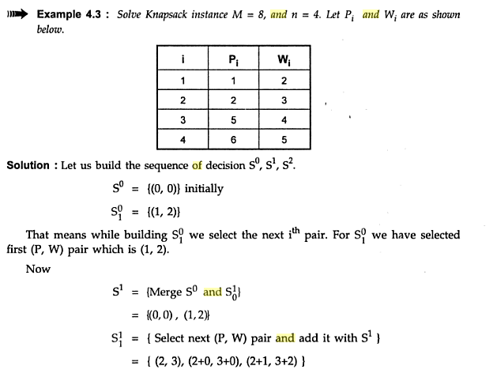

Slide 8
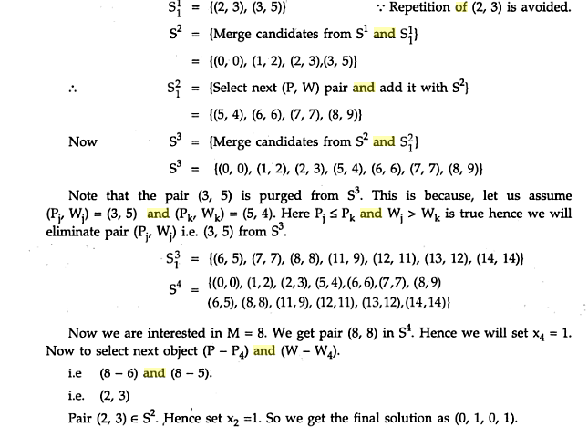

Slide 9
Example 1: Consider the knapsack instance n = 3,
(w₁,w₂,w₃) = (2,3,4), (p₁,p₂,p₃) = (1,2,5), and m = 6.
Initially
S⁰ = {(0,0)}
Include 1st object
S₁⁰ ={ ( 0+1,0+2) }= { (1,2) }
Next Stage can be obtained S⁰⁺¹ (S¹ )can be computed by merging from S⁰ and S₁⁰
S¹ ={(0,0)(1,2)}
Include 2nd object
S₁¹ ={ ( 0+2,0+3) (1+2, 2+3) }= { (2,3) (3,5) }
Next Stage can be obtained S¹⁺¹ (S² )can be computed by merging from S¹ and S₁¹
S² ={(0,0)(1,2)(2,3)(3,5)}
Include 3rd object
S₁² ={ ( 0+5,0+4) (1+5, 2+4)(2+5,3+4) (3+5,5+4) }
= {(5,4)(6,6)(7,7)(8,9)}

Slide 10
Next Stage can be obtained S²⁺¹ (S³ )can be computed by merging from S² and S₁²
S³ ={(0,0)(1,2)(2,3)(3,5) (5,4)(6,6)(7,7)(8,9)}
Apply Purging rule
Pairs(3,5) (7,7)(8,9) will be discarded
Therefore ,
S³ ={(0,0)(1,2)(2,3)(5,4)(6,6)}
X=(1,0,1)

Slide 11
Knapsack Algorithm
Algorithm DKP(p,w,n,m)
{
S⁰ := {(0,0)};
for i := 1 to n-1 do
{
S^{i-1} ={(P,W)|(P-p_{i} ,W-w_{i} ) ϵ S^{i-1} and W <= m);
S^{i} = MergePurge(S^{i-1} , S₁^{i-1});
}

Slide 12
(PX,WX) = last pair in S^{n-1} ;
(PY,WY)=(P¹+ p_{n} ,W¹+w_{n} ) where W¹ is the largest W in any pair in S^{n-1} such that W+ w_{n} <= m;
// Trace back for x_{n} ,x_{n-1},…..,x_{1.}
if (PX > PY) then x_{n} = 0;
else x_{n}=1;
TraceBackFor(x_{n-1},…..,x₁);
}

Slide 13
Program
#include< stdio.h >
#include< conio.h >
#define MAX 20
void knapsackDP(int,int);
int max(int,int);
void backtracking();
int weight[MAX],value[MAX],W,no,*x;
int v[MAX][MAX];
void main()
{ int i,j; clrscr();
printf("\n Enter number of Object you want:");
scanf("%d",&no);
printf("\n Enter weight and values in ascending order of vales");;
for(i=1;i<=no;i++)
{ printf("\n Enter Weight and Value for Object %d:",i);
scanf("%d %d",&weight[i],&value[i]);
}

Slide 14
printf("\n Enter knapsack Capacity:");
scanf("%d",&W);
knapsackDP(no,W);
backtracking(); getch();
}
void knapsackDP(int no,int W)
{
int i,j;
for(i=0;i<= W ;i++) v[0][i]=0;
for(i=0;i<= no;i++) v[i][0]=0;
for(i=1;i<= no;i++)
{ for(j=1;j<= W;j++)
{ if((j-weight[i])< 0) v[i][j]=v[i-1][j];
else
v[i][j]=max(v[i-1][j],v[i-1][j- weight[i]]+value[i]);
}
} printf("\n \t ");
for(i=0;i<= W;i++)
printf("%2d ",i);

Slide 15
printf("\n----------------------------------------------");
for(i=0;i<=no;i++)
{
printf("\n w%d=%2d v%d=%2d |",i,weight[i],i,value[i]);
for(j=0;j<= W;j++) printf("%2d ",v[i][j]);
}
printf("\n---------------------------------------------");
printf("\n Maximum value carry by knapsack is:%2d",v[no][W]);
printf("\n---------------------------------------------");
}
int max(int a,int b)
{ return (a >b)?a:b; }
void backtracking()
{ int j1,i; j1=W;
printf("\nIncluded Object \t weight \t value");
printf("\n---------------------------------------------");
for(i=no;i >=0;i--)
{ if(v[i][j1]!=v[i-1][j1] && (v[i][j1]==v[i-1][j1-weight[i]]+value[i]))
{ printf("\n%2d \t\t\t %2d \t\t 2d",i,weight[i],value[i]);
j1=j1-weight[i];
} } }

Slide 16
OUTPUT
Enter number of Object you want:5
Enter weight and values in ascending order of values
Enter Weight and Value for Object 1:1 1
Enter Weight and Value for Object 2:2 6
Enter Weight and Value for Object 3:5 18
Enter Weight and Value for Object 4:6 22
Enter Weight and Value for Object 5:7 28
Enter knapsack Capacity:11

Slide 17
0 1 2 3 4 5 6 7 8 9 10 11
----------------------------------------------------------
w0= 0 v0= 0 | 0 0 0 0 0 0 0 0 0 0 0 0
w1= 1 v1= 1 | 0 1 1 1 1 1 1 1 1 1 1 1
w2= 2 v2= 6 | 0 1 6 7 7 7 7 7 7 7 7 7
w3= 5 v3=18 | 0 1 6 7 7 18 19 24 25 25 25 25
w4= 6 v4=22 | 0 1 6 7 7 18 22 24 28 29 29 40
w5= 7 v5=28 | 0 1 6 7 7 18 22 28 29 34 35 40
------------------------------------------------------------
Maximum value carry by knapsack is:40
------------------------------------------------------------
Included Object weight value
-------------------------------------------------------------
4 6 22
3 5 18

